Slide 1
Project Title : AI Powered mental health diagnosis system
DEPARTMENT OF CSM – IV-II Sem
Project Review
Batch : 09
Team Members : IV– II:: CSM
1. 21BQ1A42F5(TL)
2. 22BQ5A4213
3. 21BQ1A42F8
4. 22BQ5A4220
Project Guide:
MR. MD. SYED

Slide 2
Abstract
Mental health disorders are a pressing global concern, yet barriers such as stigma, limited access to professional care, and subjective diagnostic methods hinder timely intervention. This project introduces an AI-powered system designed to overcome these challenges by offering interactive mental health assessments, early disorder detection, and evidence-based therapy recommendations. By leveraging advanced technologies like natural language processing (NLP), sentiment analysis, and machine learning, the platform ensures accurate evaluations and personalized interventions tailored to users' needs.
The system incorporates validated psychological scales for assessments and recommends therapies such as cognitive-behavioral techniques, mindfulness practices, or referrals to professionals. Additionally, it prioritizes user privacy and ethical handling of sensitive data to build trust and reliability. By integrating technology with mental health care, this project aims to empower individuals, reduce diagnostic delays, and provide accessible, scalable solutions to enhance mental well-being globally.

Slide 3
Introduction
Mental health diagnosis is often hindered by stigma, accessibility issues, and subjective methods, delaying necessary interventions. The AI-powered system addresses these challenges using technologies like NLP, sentiment analysis, and machine learning. It ensures early detection and personalized therapy recommendations for users.
Key functionalities include interactive assessments based on validated psychological scales and a recommendation engine for therapies like CBT, mindfulness, or professional referrals. Its user-friendly interface ensures accessible and meaningful mental health support tailored to individual needs.
With robust data security and ethical handling of sensitive information, the platform builds trust among users. Real-time feedback and continuous learning improve the system's accuracy and effectiveness over time.
This innovative solution empowers individuals to manage their mental well-being proactively. It bridges the gap between mental health needs and care services by providing scalable, accessible, and evidence-based mental health support globally.

Slide 4
Existing System
Traditional mental health diagnostic systems include in-person consultations, self-reported surveys, and standardized psychological assessments. These methods rely heavily on the expertise of professionals and subjective user inputs. While effective in structured environments, these systems are limited by accessibility, high costs, and long wait times.
Additionally, the absence of features like voice assistance, interactive chat support, and seamless social sharing further limits their usability and appeal to users.
Problems Associated:
Accessibility: Many individuals lack access to mental health professionals due to geographic or financial constraints.
Stigma: Social stigma prevents individuals from seeking help, leading to undiagnosed or untreated conditions.
Delays: Long waiting periods for consultations delay critical interventions.
Subjectivity: Reliance on self-reported data and manual evaluations introduces biases, affecting diagnostic accuracy.
Absence of Real-Time Assistance: Diagnosis often face difficulties resolving queries or seeking guidance while on the go.

Slide 5
Objective
The main objective of this project is to create an AI-powered mental health diagnosis system that provides accessible and accurate mental health assessments. By utilizing advanced technologies such as natural language processing (NLP) and machine learning, the system aims to offer early identification of mental health conditions, allowing users to receive timely interventions.
By leveraging services like mood diary, guided workouts, AI chatbots, Progress reports, Relaxation tools and personalized insights we help users to empower their mental health well-being with AI solutions that minimizes the problem of accessibility, real time monitoring, Delays etc.
The ultimate goal is to create an intuitive and reliable platform by enabling real-time feedback, ensuring data privacy, and providing an easy-to-use interface, the project strives to empower individuals to take control of their mental well-being and bridge the gap between users and professional care.

Slide 6
Comparitive analysis
Traditional Mental Health Assessments vs. AI-Powered Mental Health Diagnosis: Traditional assessments are often limited by self-reported data and manual evaluations, which can be subjective and time-consuming. The AI-powered system, on the other hand, offers real-time analysis using NLP and sentiment analysis, providing more objective and timely assessments with personalized recommendations.
In-Person Therapy vs. AI-Powered Mental Health Diagnosis: In-person therapy is valuable for personalized care but may involve scheduling delays and geographic limitations. AI-powered system offers scalable, accessible mental health support, without the constraints of time or location.
Self-Diagnosis Tools vs. AI-Powered Mental Health Diagnosis: Self-diagnosis tools often lack accuracy and validation, leading to unreliable results. In contrast, the AI-powered system utilizes validated psychological scales and continuously refines its models to provide accurate, data-driven results that can be trusted for early detection and tailored interventions.

Slide 7
Technology stack
1. Frontend:
Django Templates: Used for dynamic HTML rendering.
Bootstrap: For responsive UI design.
2. Backend :
Django: Python-based backend framework.
Django REST Framework (DRF): For API development.
MySQL: Primary database for production.
SQLite: Used for local development.
3. Machine Learning:
TensorFlow or PyTorch for developing and deploying AI models for sentiment analysis and behavior prediction.

Slide 8
Future Enhancements
1.Offline Mode: Introduce offline access for services, recommendations to support users in areas with poor connectivity.
2.Multi-Language Support: Expand accessibility by incorporating support for multiple languages to cater to a diverse global audience.
3.AI-driven Virtual Therapist: Developing a more advanced virtual therapist that provides real-time counseling and interventions, mimicking human-like conversations for deeper emotional support.
4. Integration with Wearable Devices: Syncing with wearable health devices (e.g., smartwatches) to gather real-time physiological data, enhancing mental health monitoring and prediction.
5. Expanded Therapy Recommendation Engine: Incorporating a wider range of therapeutic options, including advanced AI-driven meditation techniques and virtual group therapy sessions.

Slide 9
Test cases and screenshots
1. User Authentication
- Test Case: Verify that a user can successfully register, log in, and log out using valid credentials.
- Expected Result: The user should be able to register, log in with the correct username and password, and log out without any errors.
2. Chatbot-Interaction
- Test Case: verify if Displays a back-and-forth conversation between the user and the chatbot.
- Expected Result: Chatbot processes the input and responds based on pre-defined logic.
3. Dashboard Page
- Test Case: Verify that the app provides accurate step-by-step directions from the user's current location to a selected destination.
- Expected Result: The user should receive accurate, real-time navigation instructions and be able to access every service.

Slide 10
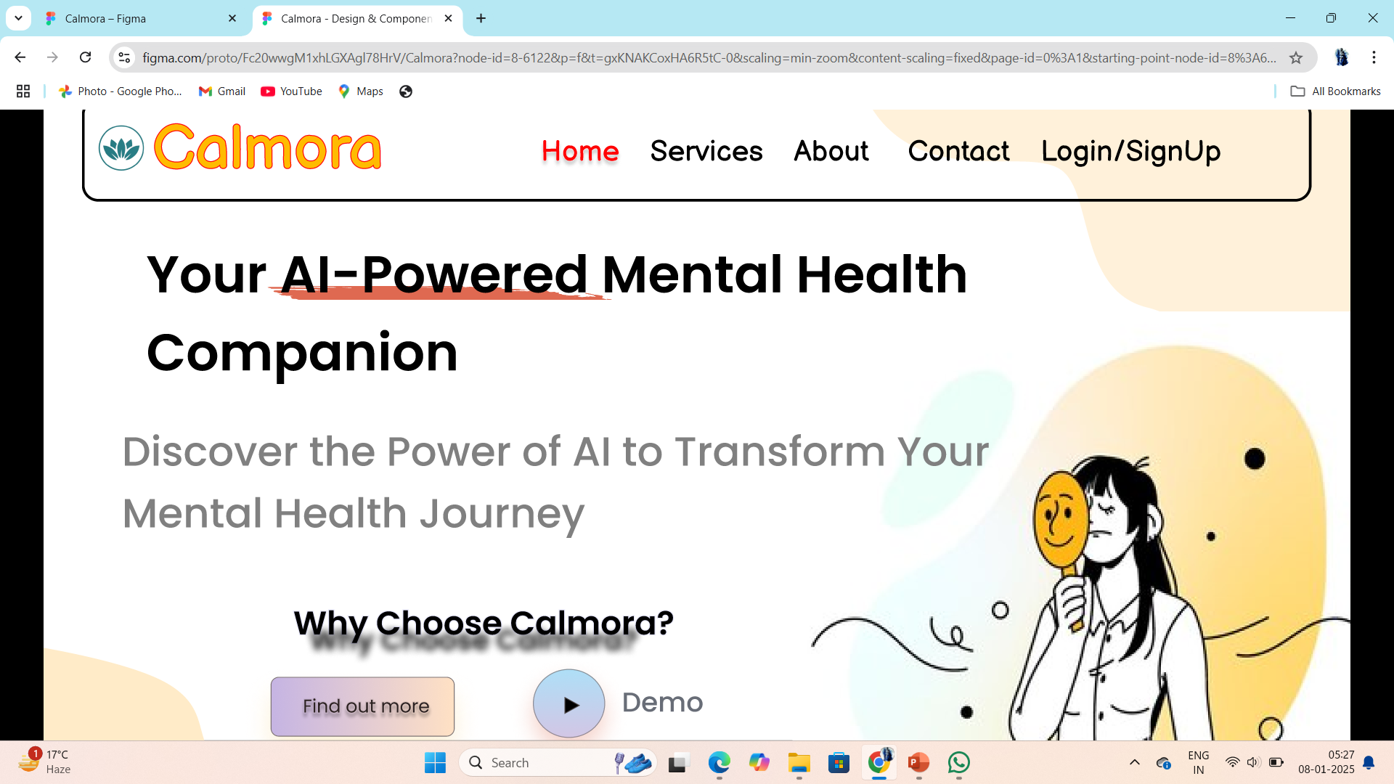
Screenshots

Slide 11
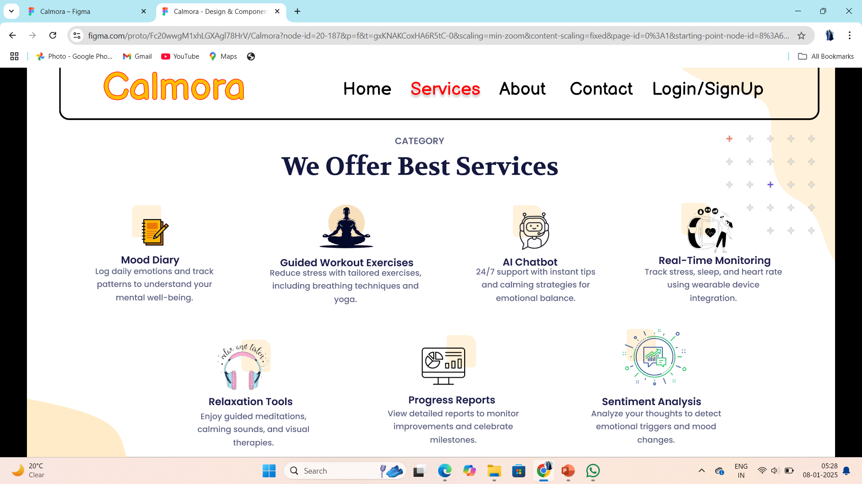
Screenshots

Slide 12
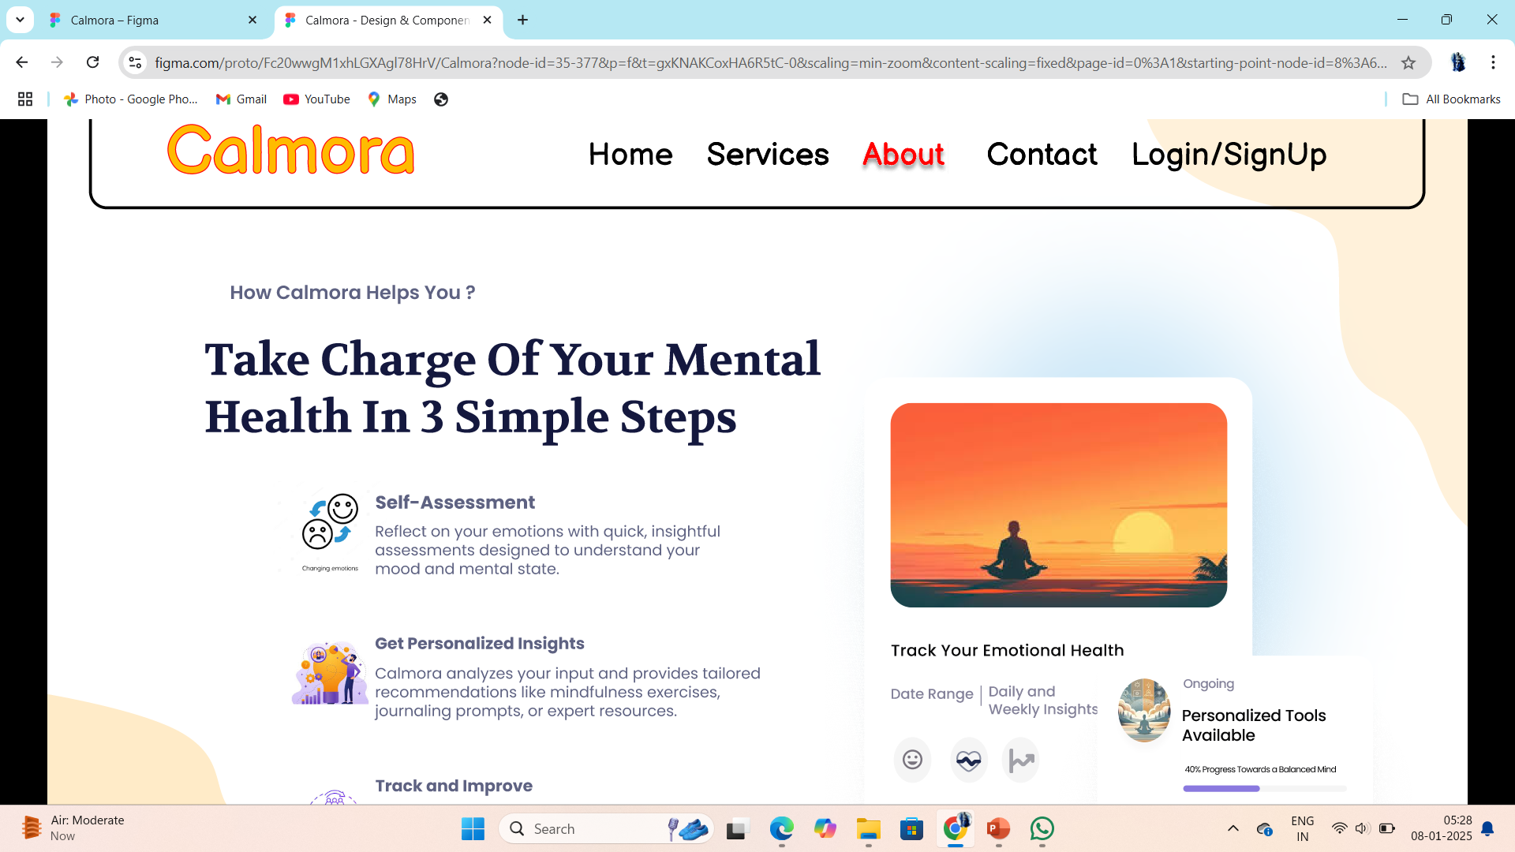
Screenshots

Slide 13
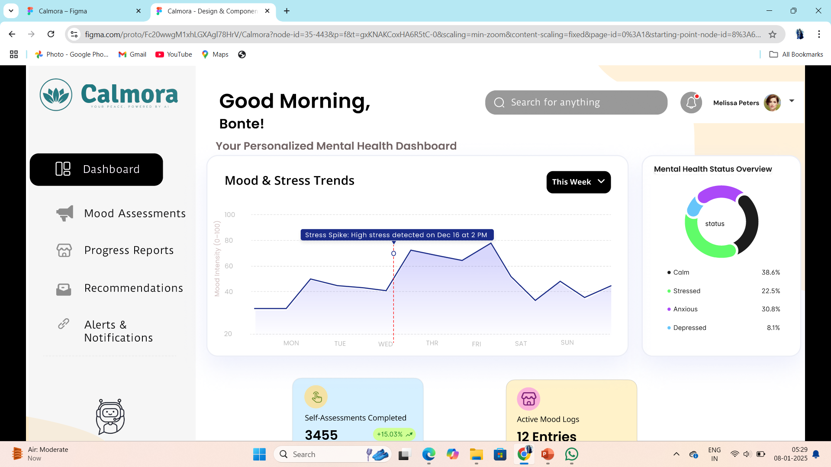
Screenshots

Slide 14
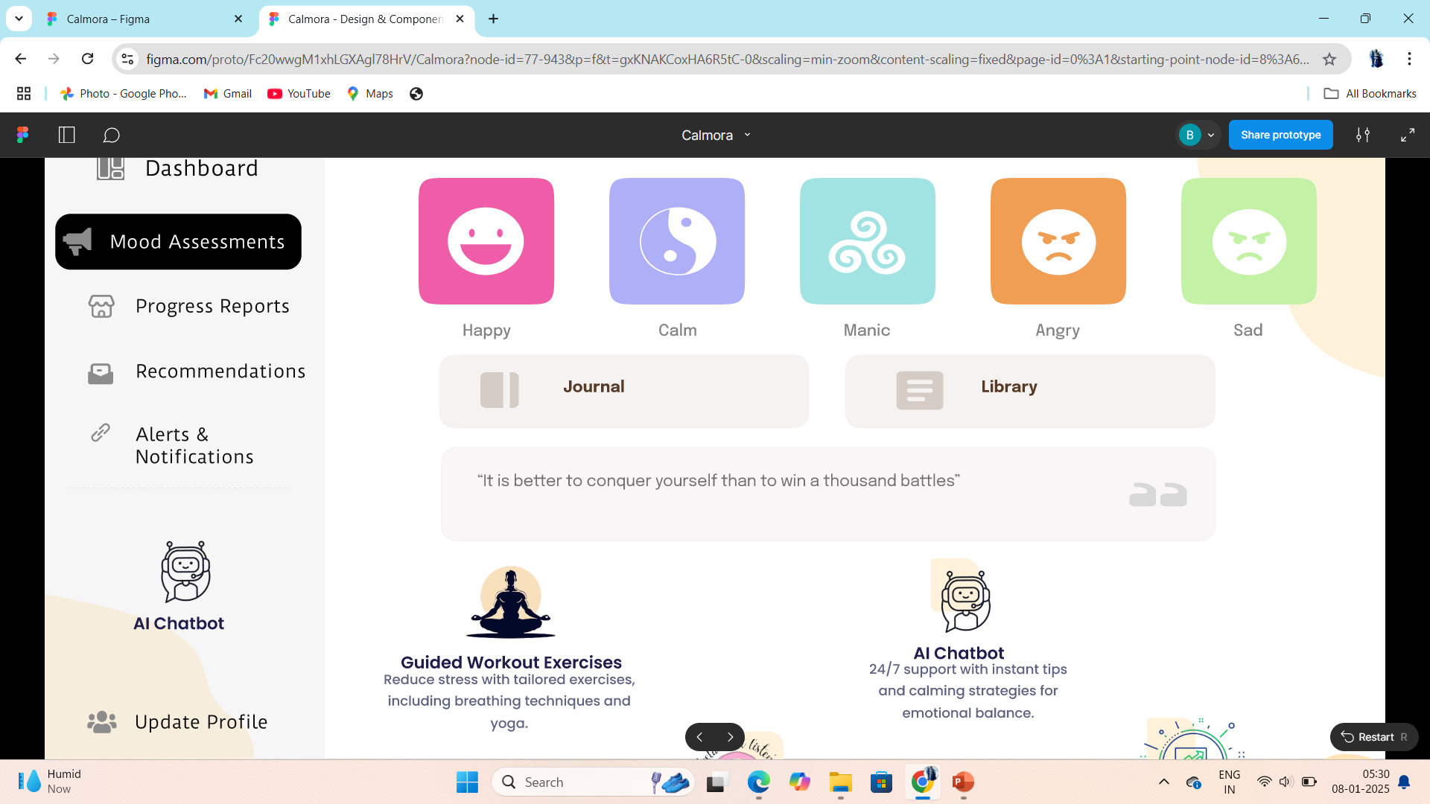
Screenshots

Slide 15
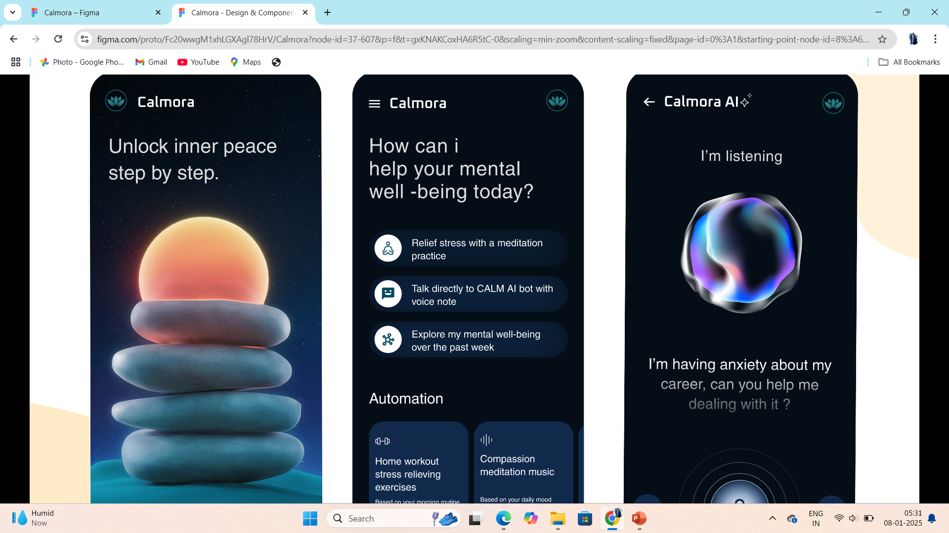
Screenshots

Slide 16
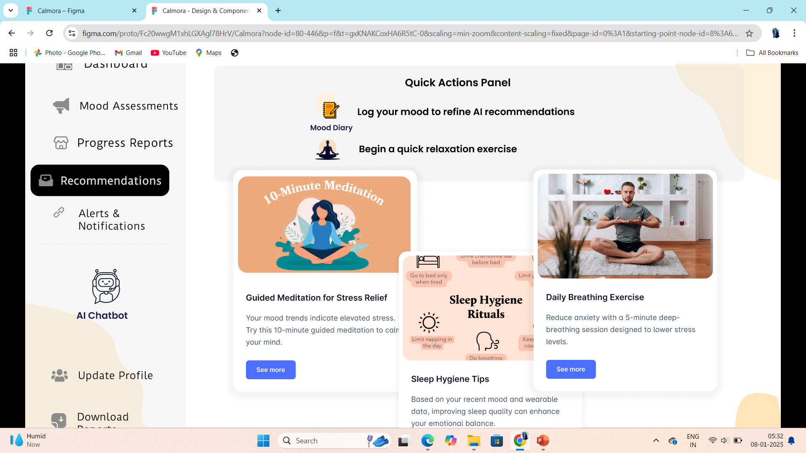
Screenshots

Slide 17
Conclusion
In conclusion, an AI-powered mental health diagnosis system holds immense potential to revolutionize mental healthcare by providing timely, accurate, and accessible support. By leveraging advanced algorithms, such systems can analyze complex patterns in patient data, enabling early detection and personalized interventions. While ethical considerations and data privacy remain paramount, this innovative approach paves the way for enhanced mental well-being and bridges the gap between traditional mental health services and modern technological solutions.

